Slide 1


Covid-19 Data Analysis
Presented By:
Anvitha Shashidhar
Chirag Sable

Slide 2

Agenda
Introduction
Dataset Information
Python packages
Constraints
Visualizations
Code
Conclusion

Slide 3
Introduction
The Covid-19 pandemic has affected our lives in many ways, and it continues to be a major public health challenge globally.
The pandemic has forced us to adapt to new ways of living and working, and it has highlighted the importance of public health policies and interventions.
In this project, we will be sharing with you an analysis of Covid-19 data for the world, India, and the USA.
The data includes information on the number of cases, deaths, and recoveries, as well as trends over time.

Slide 4
Dataset Information
Semi-structured dataset
We have a total of 7 datasets that we have used in this project
Datasets include:
Covid cases India
Covid vaccine India
Covid test India
Covid cases USA
Covid USA counties
Covid US daily agg.
Covid case world

Slide 5
Python Packages
1) NumPy:
NumPy is a powerful package for scientific computing in Python, and it is widely used for data analysis and numerical calculations.
2) Pandas:
Pandas is a Python library for data manipulation and analysis. It provides a range of tools and functions for handling structured data, including data cleaning, filtering, merging, and aggregation.
3) Matplotlib:
Matplotlib is a Python library for creating static, animated, and interactive visualizations in Python. It is widely used for creating graphs, plots, and charts to visualize data and communicate insights.
4) Seaborn:
Seaborn is a Python data visualization library based on Matplotlib. It provides a high-level interface for creating informative and attractive statistical graphics in Python.

Slide 6
Constraints
Merging data
Null values
Negative values

Slide 7

Code

Slide 8
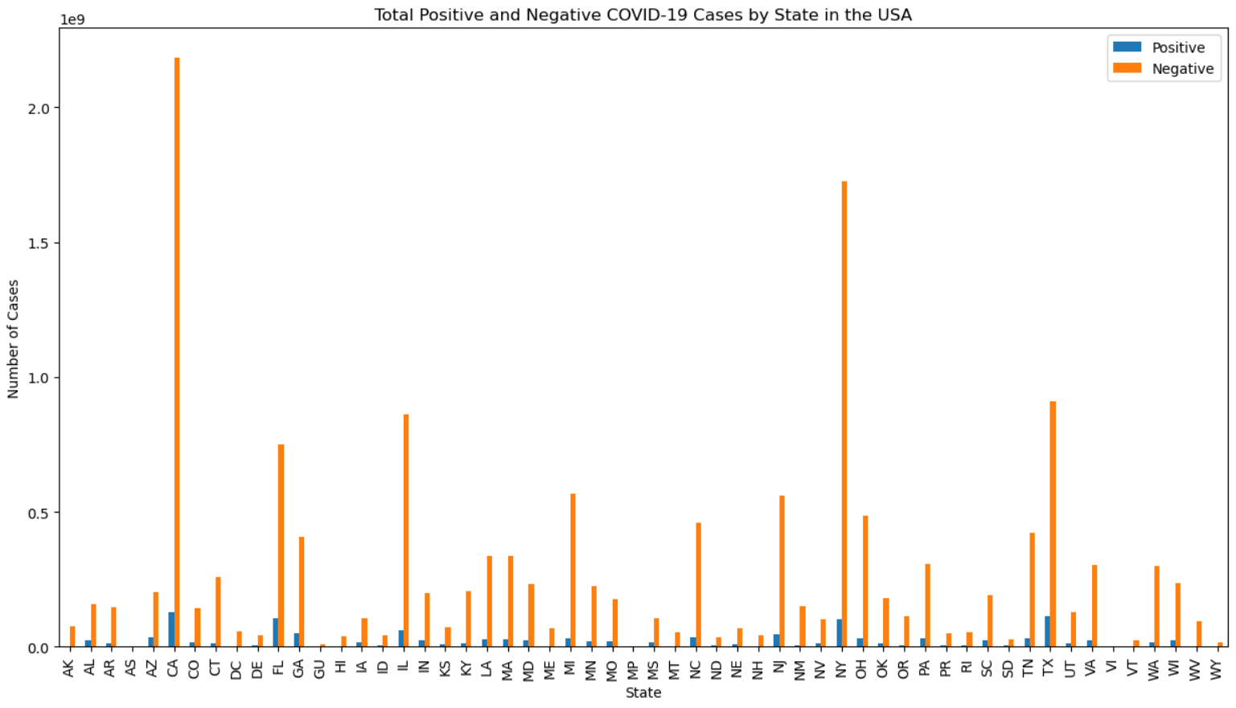
Visualizations

Slide 9
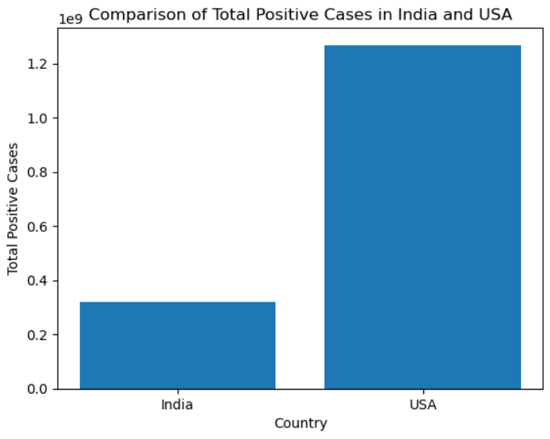
Visualizations

Slide 10
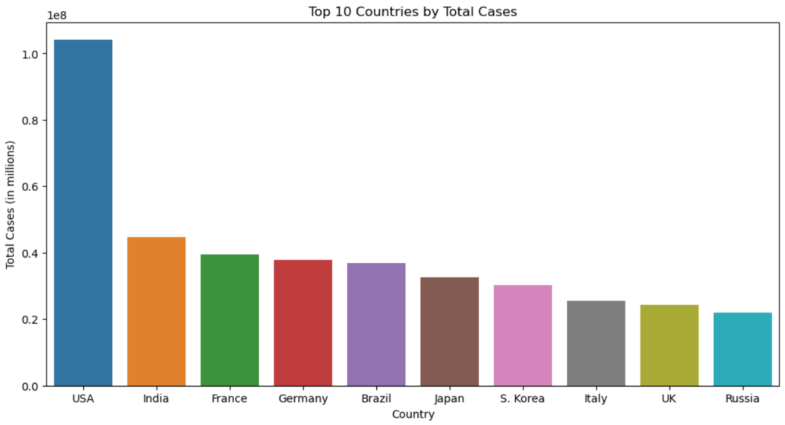
Visualizations

Slide 11
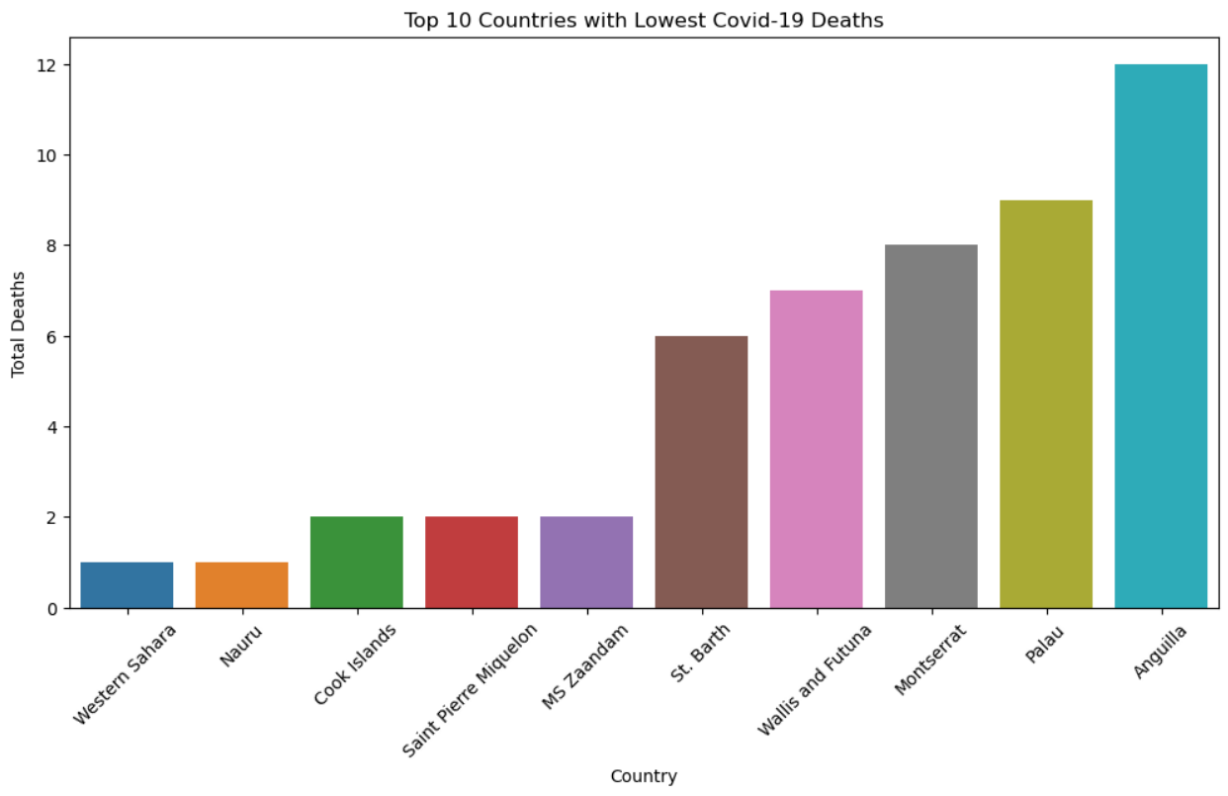
Visualizations

Slide 12
Conclusion
Overall, the USA had more cases than India and Worldwide
The recovery percentage of India was more than the USA

Slide 13
Thank You!

